Slide 1
Fire Extinguisher Inspection
Step by Step Approach

Slide 2
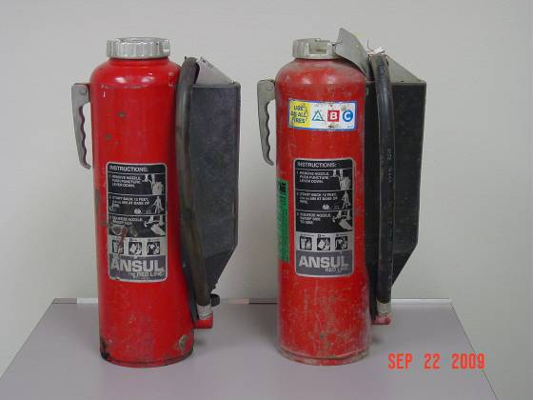
No obstruction to access or visibility

Slide 3
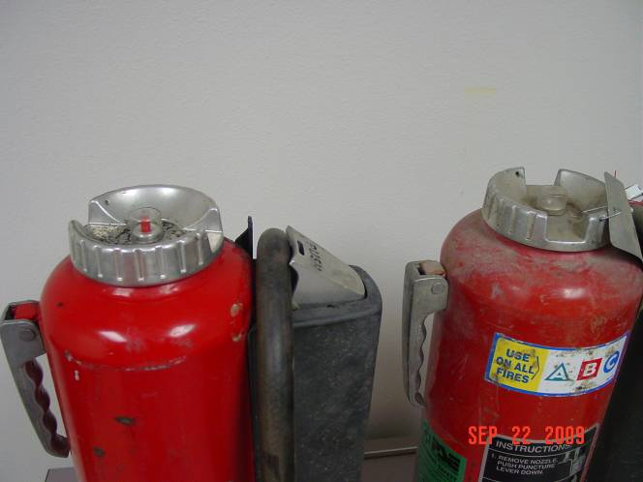
Look to see if the indicator button is down.

Slide 4
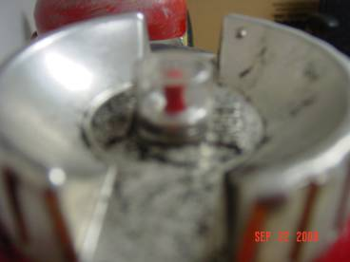
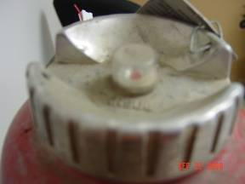
If the button is up remove the unit from service

Slide 5
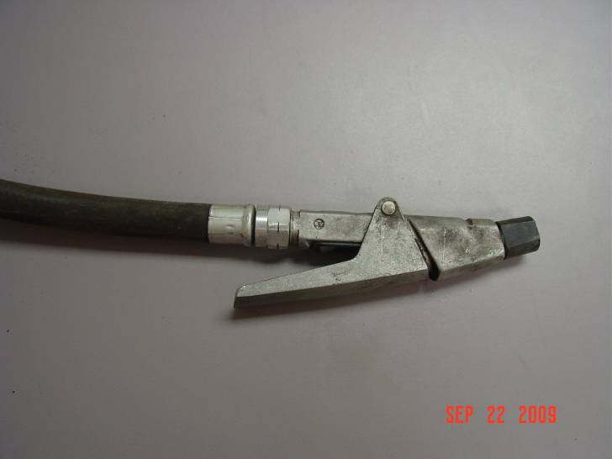
Visually inspect the hose and nozzle to ensure they are in good condition.

Slide 6
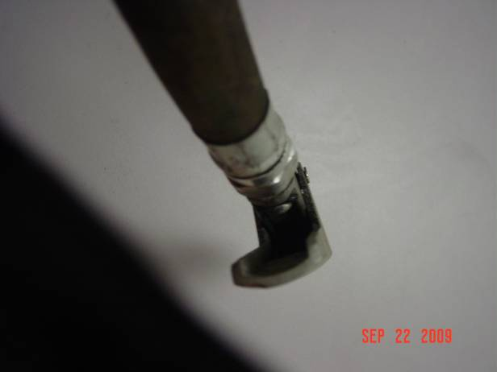
Examine for obvious physical damage, corrosion, leakage, or clogged nozzle.

Slide 7
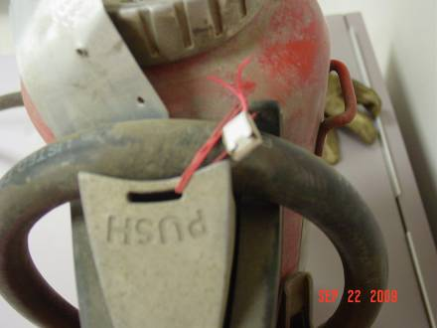
Inspect the plunger and co2 cartridge.

Slide 8
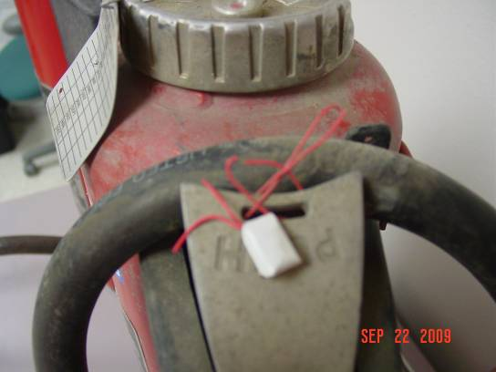
Remove the hose. Don’t worry if the tie has not been broken.

Slide 9
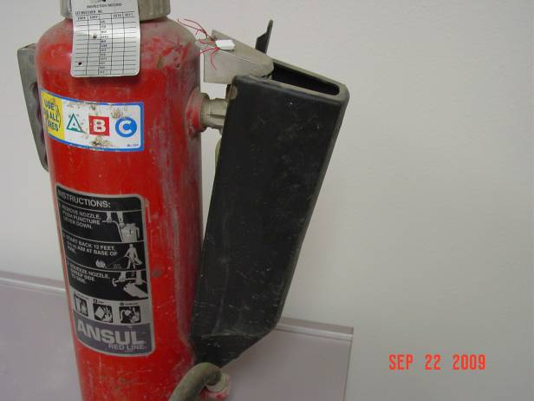

Remove the black cover from the co2 cartridge

Slide 10
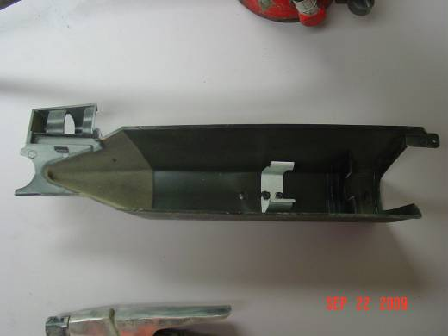
Check for mud/coal or other material under the cover. Clean out any foreign material found.

Slide 11
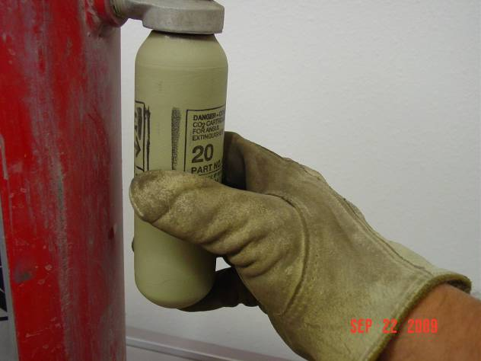

Remove the co2 cartridge.

Slide 12
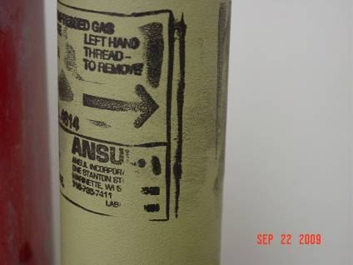
Left hand thread to remove.

Slide 13
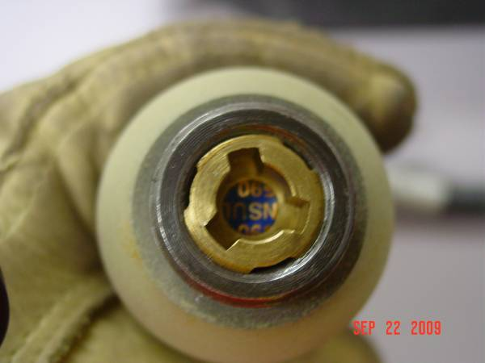
Check the foil seal.

Slide 14
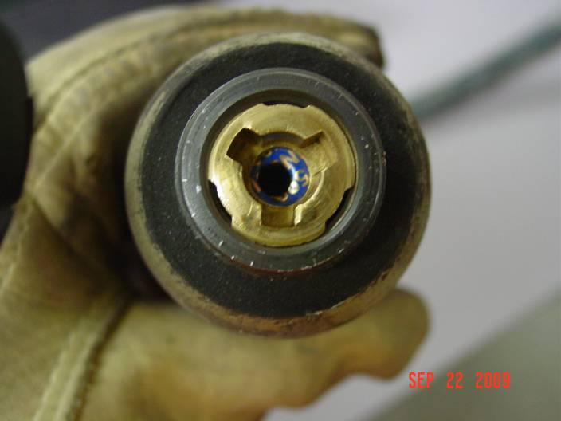
If the foil seal has been punctured remove the unit from service.

Slide 15
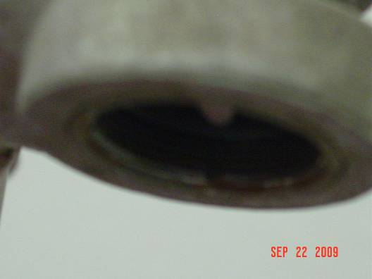
Make sure plunger opening is clear of obstructions.

Slide 16
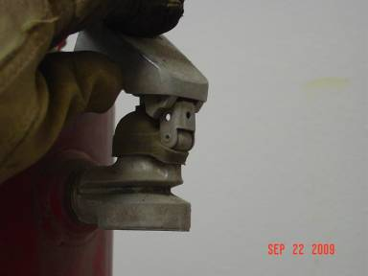
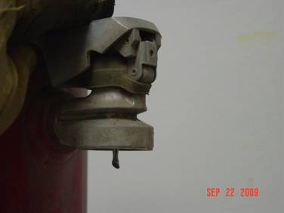


Check action of plunger. Is it free? If not clean it out.

Slide 17
Be sure to lift the plunger before replacing the co2 cartridge

Slide 18

Replace the co2 cartridge.

Slide 19
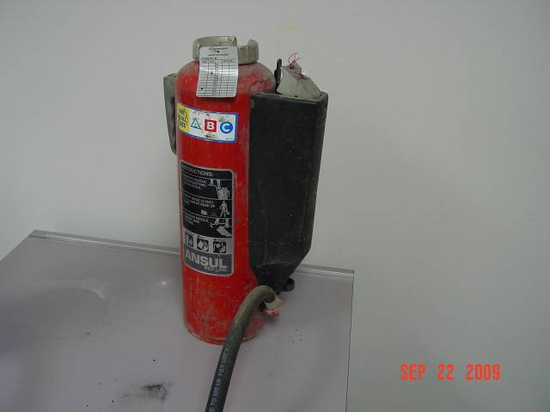
Replace the canister, black cover and hose.

Slide 20
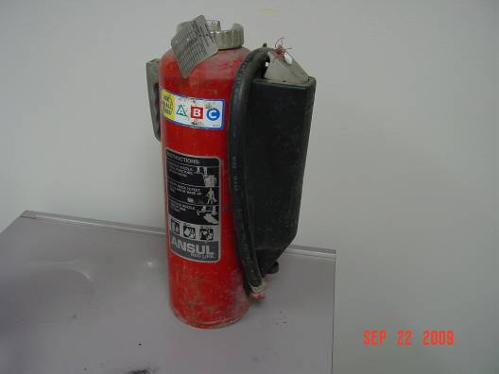
Visually inspect the extinguisher for dents, leaks, rust, chemical deposits or other signs of abuse/wear.

Slide 21
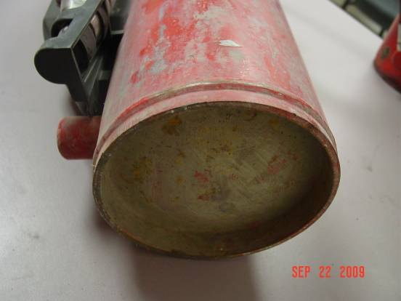
Inspect the condition of the bottom of the fire extinguisher.
damage
rust
wear
abuse

Slide 22
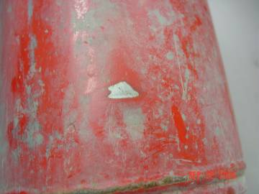
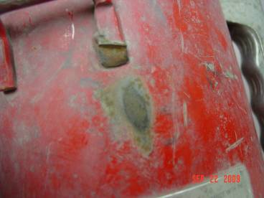
Examine wear spots. Are they substantial?
If the extinguisher is damaged or needs
recharging, remove it from service.

Slide 23
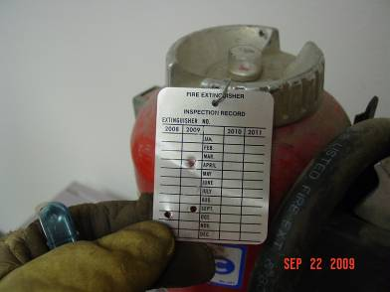
Once the inspection is complete punch the tag in the correct location.

Slide 24
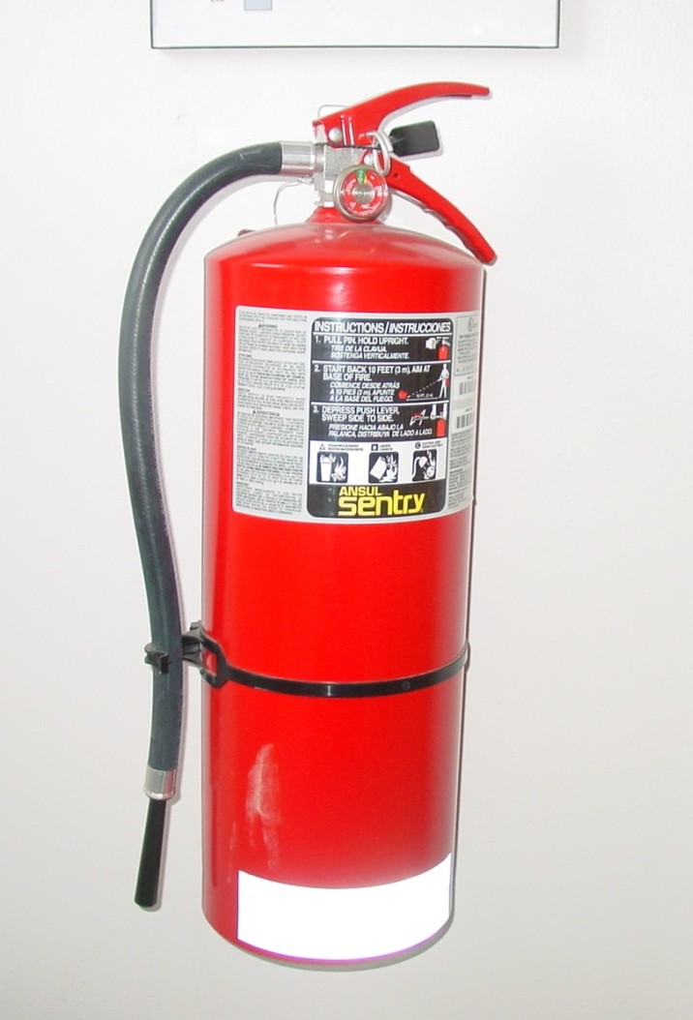
Inspection of an internally charged fire ext.
Inspect for
damage
rust
wear

Slide 25
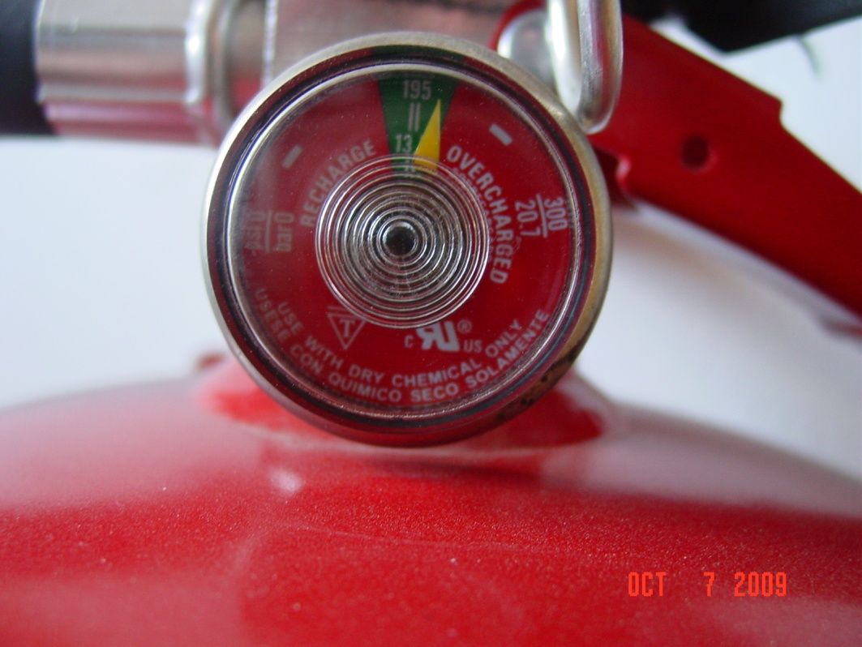
The dial on the pressure gauge should be in the green zone or operable zone. If it is in the red zone, remove the unit from service.

Slide 26
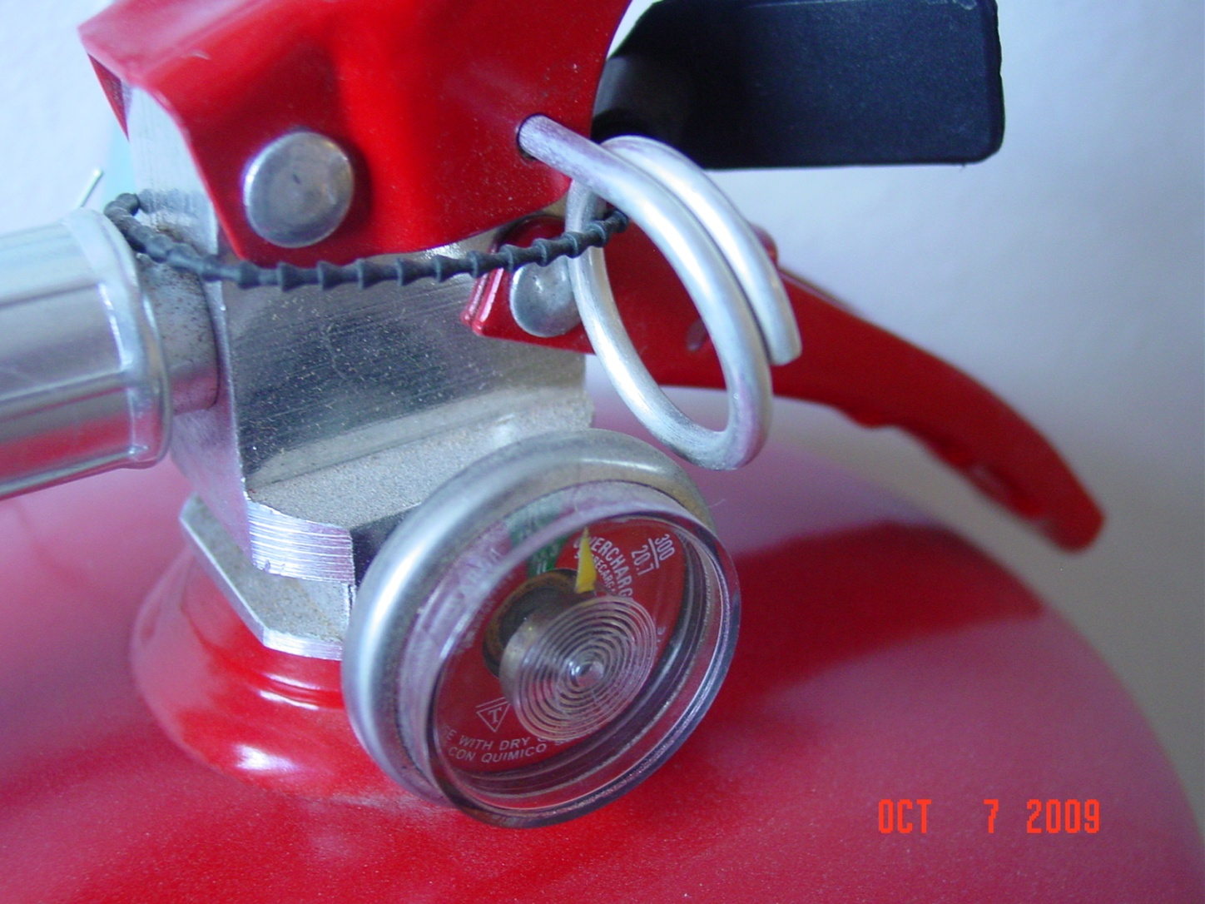
Make sure the pin is in place.

Slide 27
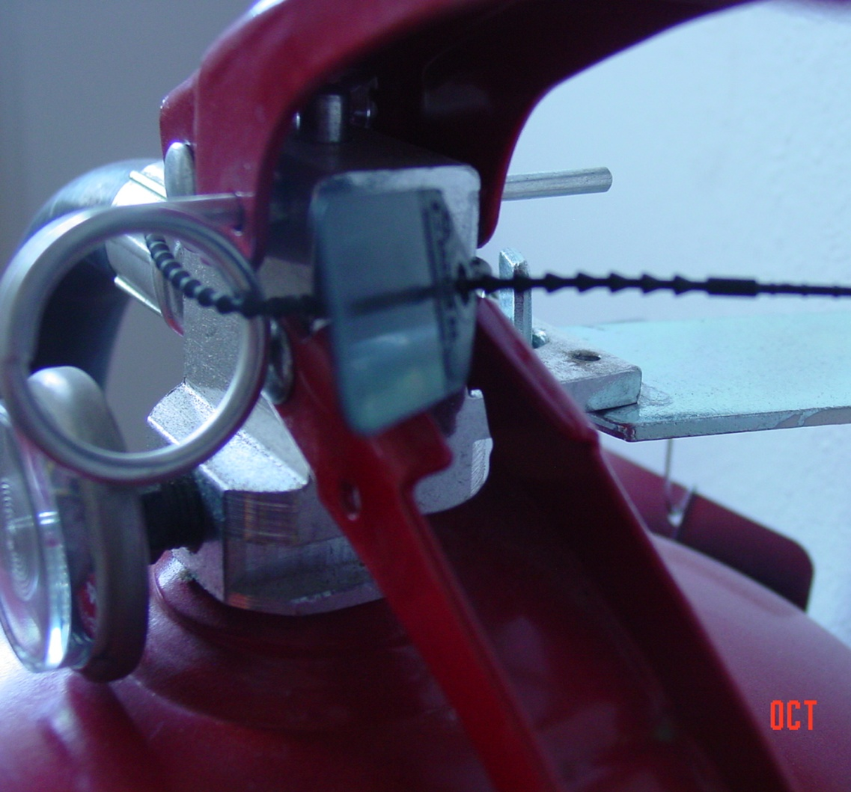
Check for obstructions around actuator lever
Mud
dirt
coal

Slide 28
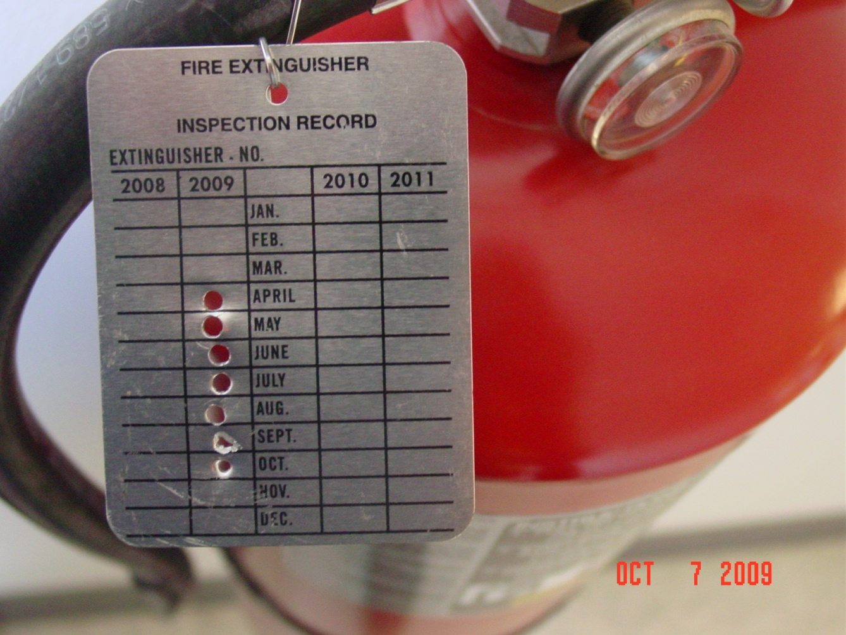
Punch the tag in the correct location.

Slide 29
Summary:
No obstructions
Actuator pin is up/dial is in operable zone
Hose, co2 canister, and housing are OK.
The inspection tag has been properly punched.
Thank You.

